Slide 1
Rest Server
Jersey Libraries

Slide 2
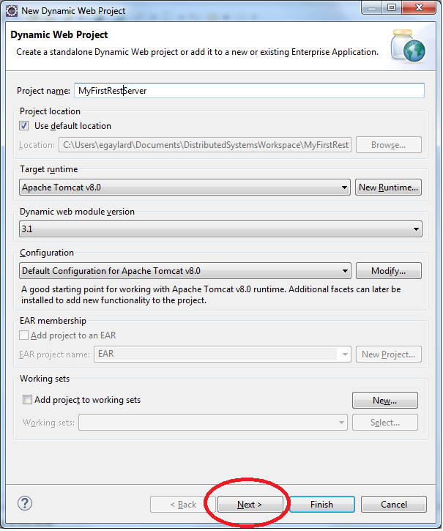
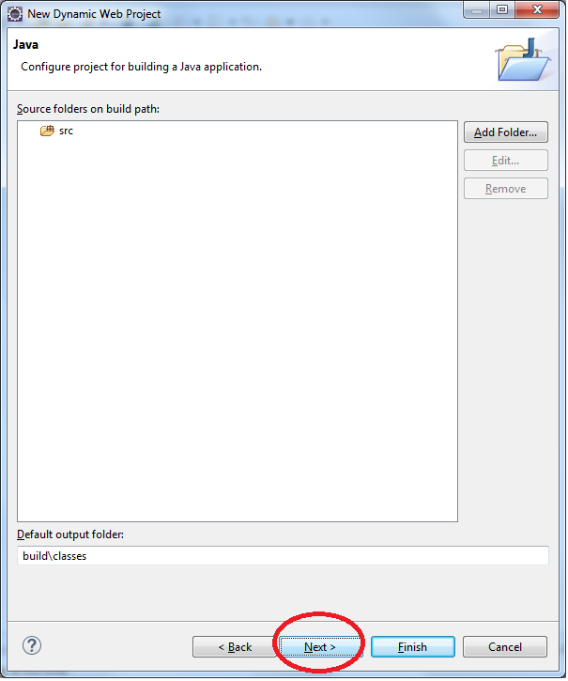
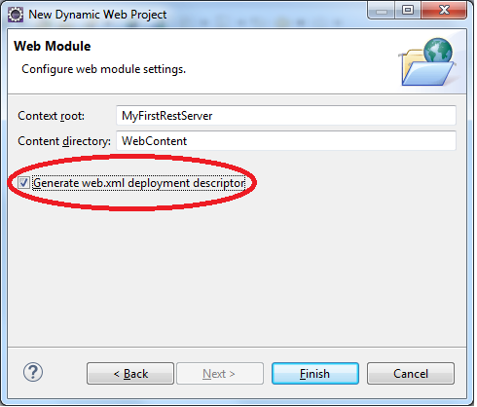
Eclipse Setup
1.
2.
Open JavaEE perspective
Create a new Dynamic Web Project
Enter an name for project
Click NEXT not finish !
Click Next again on 2nd Screen
Then on 3rd screen click Checkbox ‘generate web.xml descriptor’
Click Finish
3.

Slide 3
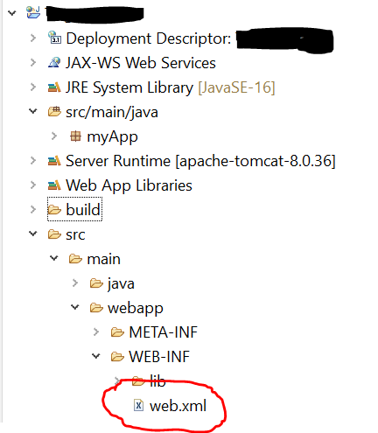
Generating Web.xml
If you missed the steps i.e. forget the checkbox on project creation and no Web.xml file in Meta-Inf Folder
Right Click on Project and select JEE Tools -> ‘Generate Deployment Descriptor Stub’
Now you should have a Web.xml file in Meta-Inf folder

Slide 4
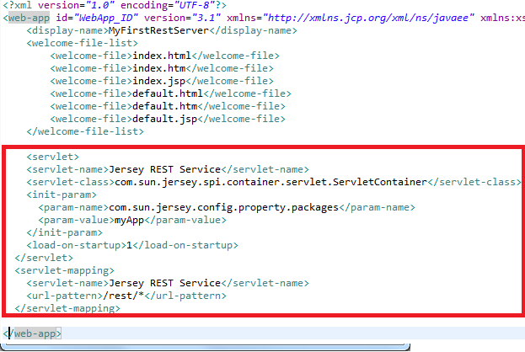
Editing Web.xml
Open this web.xml file and change view to source if design view appears
Add the following lines after </welcome-file-list>
and before
</web-app>
Click Save
This lets our project know about Jersey REST Service Mappings !

Slide 5
Content to insert in Web.xml
<servlet>
<servlet-name>Jersey REST Service</servlet-name>
<servlet-class>com.sun.jersey.spi.container.servlet.ServletContainer</servlet-class>
<init-param>
<param-name>com.sun.jersey.config.property.packages</param-name>
<param-value>myApp</param-value>
</init-param>
<load-on-startup>1</load-on-startup>
</servlet>
<servlet-mapping>
<servlet-name>Jersey REST Service</servlet-name>
<url-pattern>/rest/*</url-pattern>
</servlet-mapping>

Slide 6
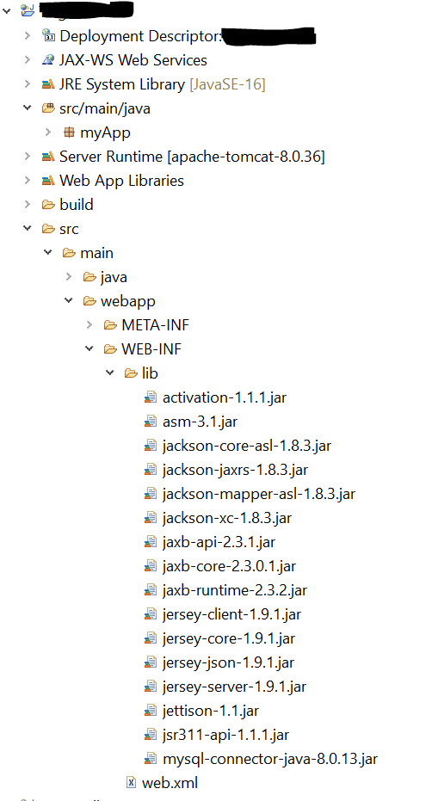
Jersey Libraries
Expand src/main/webapp folder
In Web-INF/lib paste jars from jars.zip
Do not add these to build path

Slide 7
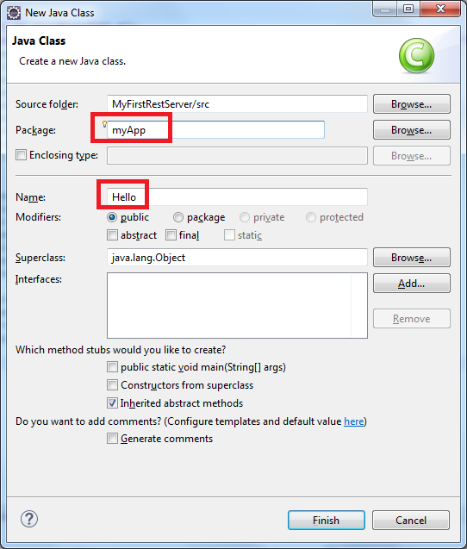
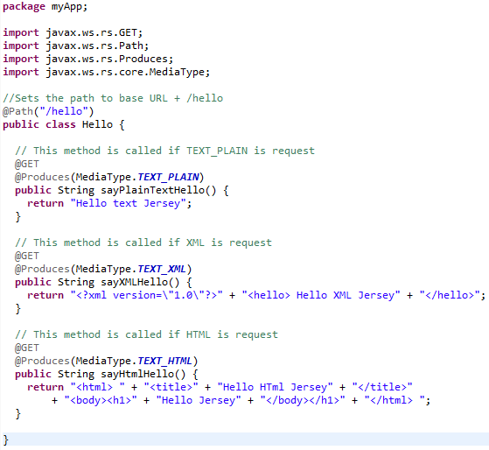
Create First Server File
Right click on src folder and create new Java class called ‘Hello’ in a package called ‘myApp’
Add following code to the class and save

Slide 8
Code for First Server File
package myApp;
import javax.ws.rs.GET;
import javax.ws.rs.Path;
import javax.ws.rs.Produces;
import javax.ws.rs.core.MediaType;
//Sets the path to base URL + /hello
@Path("/hello")
public class Hello {
// This method is called if TEXT_PLAIN is request
@GET
@Produces(MediaType.TEXT_PLAIN)
public String sayPlainTextHello() {
return "Hello text Jersey";
}

Slide 9
Code for First Server File (part2)
// This method is called if XML is request
@GET
@Produces(MediaType.TEXT_XML)
public String sayXMLHello() {
return "<?xml version=\"1.0\"?>" + "<hello> Hello XML Jersey" + "</hello>";
}
// This method is called if HTML is request
@GET
@Produces(MediaType.TEXT_HTML)
public String sayHtmlHello() {
return "<html> " + "<title>" + "Hello HTml Jersey" + "</title>"
+ "<body><h1>" + "Hello Jersey" + "</body></h1>" + "</html> ";
}
}

Slide 10
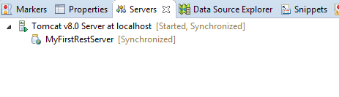
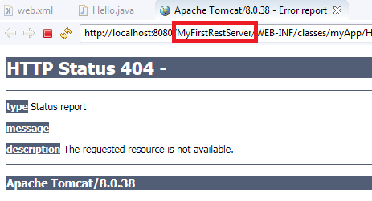
Run on Apache Tomcat 8 Server
When you run file on apache server, you will be redirect to a 404 page
We can ignore this for now !
Most importantly is that our Server is now running and awaiting calls !

